Slide 1
Materials
Workshop 11/15

Slide 2
Recording

Slide 3
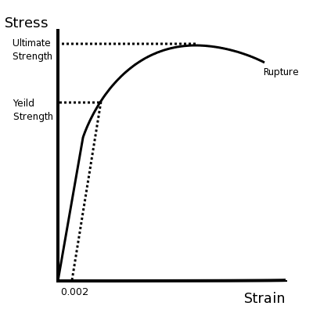
Basics
Yield strength: the force it can take before exiting plasticity
Plasticity: when it is deformed but not permanently
Synthesis: yield strength: the force it can take before deforming permanently
Ultimate strength: the total force it can take before breaking

Slide 4


Nomenclature
Note: sometimes on the forum:
“= pounds
Note: pounds are NOT the same as pound forces
Pound force:
Slug: 32.1740 lb
Yes, this is confusing and sorta dumb. Metric please
psi : pound forces per square inch
ksi: thousand pound force
MPa: megapascals (also 10.1972 kg/cc)
Pascals:
cc: square centimeter
Newton: the SI unit of force
Joul: SI unit of energy

Slide 5

Strength to Weight
Ratio of yield strength/ density
6061 t6 Aluminum
Yield strength: 276 MPa (aka 2814.42 kg/cc)
Density: 2.70 g/cc
Strength to weight:
Which equals: 1.04
For comparison, 4130 chromoly steel is half that

Slide 6
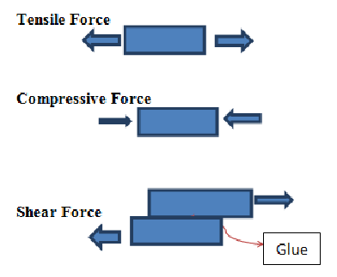
Tensile vs Compression vs Shear vs Bearing
Notes:
Tensile *0.7 = shear

Slide 7
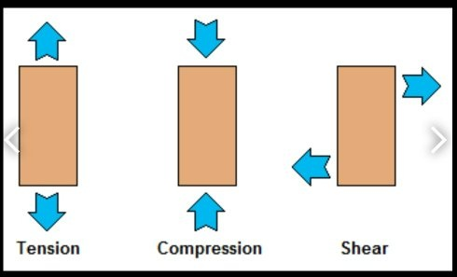
Internal forces

Slide 8
Aluminum Denotation
First 4 digits: specific alloy
Ex. 6061 means it has some magnesium and silicon
t# : heat treatment
So 6061-t6 is MUCH (4x) stronger than 6061-O (not treated at all)
What heat treating is:
Take 6061-O aluminum, heated it to 990˚ F
then submerge it in water
aged at about 350˚ F for around 8 hours
Don’t need to know how to heat treat, but DO take into account the treatment of your alum
Notes:
6061 t6 aluminum

Slide 9
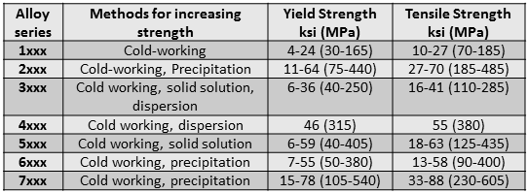
Types of Alum
The 7 series can only be bought from Aircraft spruce (nationwide)
sUPER expensive

Slide 10
Note
All different aluminum with different heat treatments have different yield strengths
Research is your BEST FRIEND
How do you find this information?
Glad you asked! here’s your answer

Slide 11
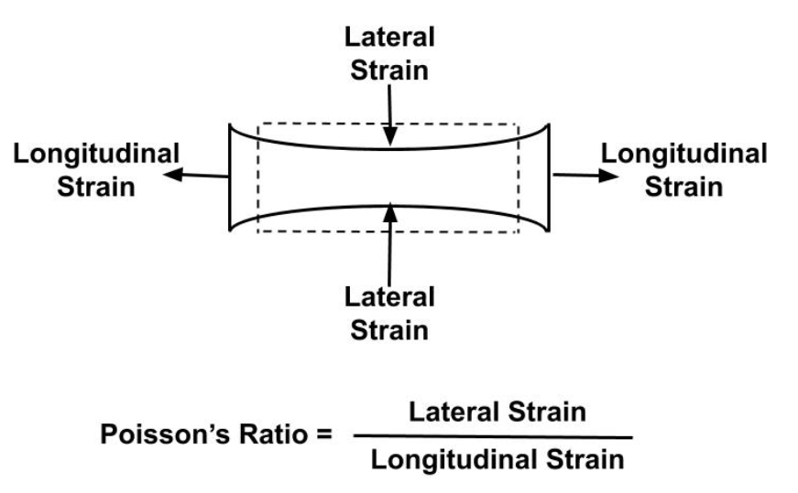
http://www.matweb.com/Search/MaterialGroupSearch.aspx?GroupID=9
Everyone go here and dig around for a bit ; Here’s some quick definitions:
Poisson's ratio technical term: “ measure of the Poisson effect, the phenomenon in which a material tends to expand in directions perpendicular to the direction of compression”
Aka: ratio of if you squish it one way how far up will it go the other way

Slide 12
Also: https://www.youtube.com/channel/UCXAS_Ekkq0iFJ9dSUIkcAkw
The Efficient Engineering Channel
ALL you need to know about materials + forces

Slide 13
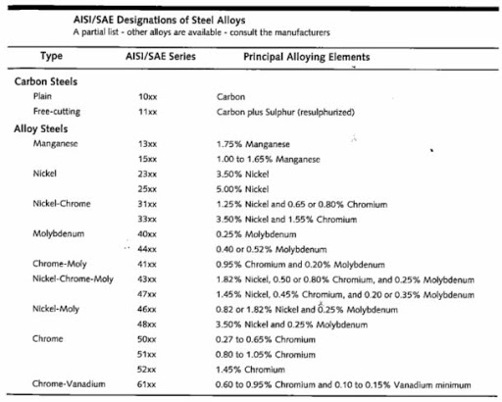
Steel
First 4 digits → again, denotes the alloy
Heat treatment does not vary per alloy so don’t need to worry about “t#”
HIGH strength, very heavy → low strength to weight ratio
Easier to weld

Slide 14
To recap: Alum vs Steel
Aluminum:
Lots of types (but harder to find anything not 6061 t6)
However can find some 2024 or 5052 t52 sheet metal
higher strength to weight
Hard to weld
Steel
A few types (we’re using Chromoly steel 4130)
Hard to find anything not this
Easier to weld
Low strength to weight

Slide 15
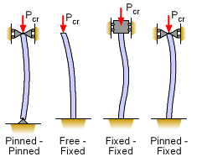

Column Buckling
Euler Formula
Very simple, complicated things:
K: effective length factor, depends on →
E: elastic modulus of material
A property like yield strength , how much it resists bending

Slide 16
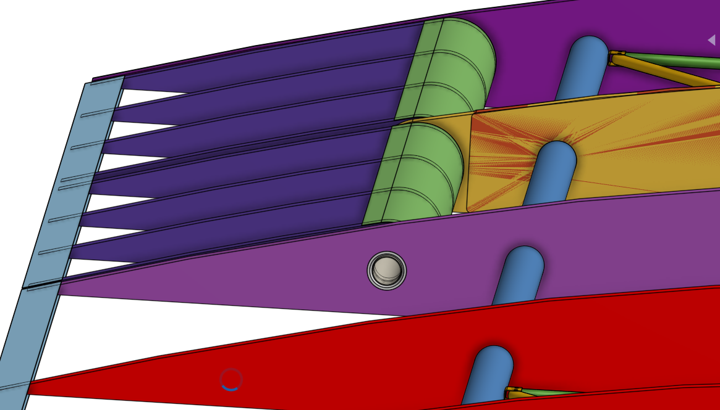
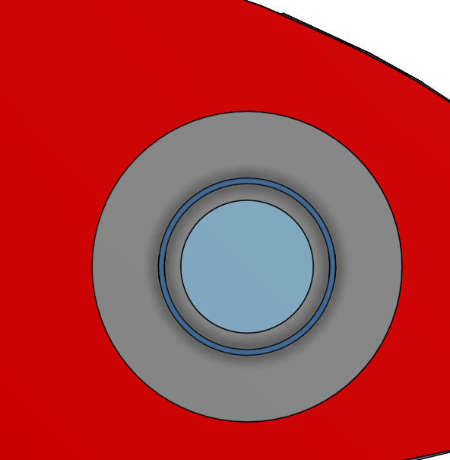
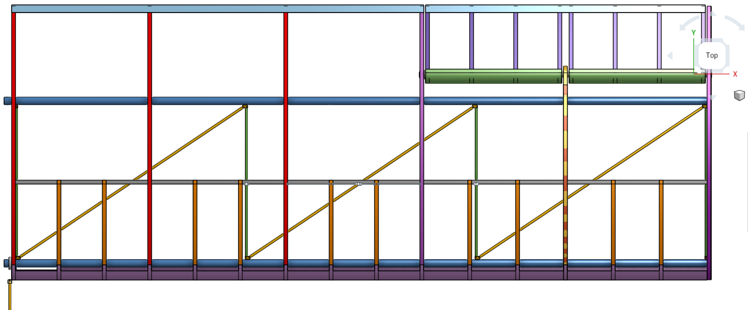
Usage on the Plane: Wing
Everything metal is (supposed to be) 6061 t6 aluminum
Spars are 2” x 0.035”
Support washers are 0.016” 5052 t52 (by accident)
Aileron is 1.5” x 0.035”
Drag + Compression struts (cross web members): 5/16” x 0.035”

Slide 17
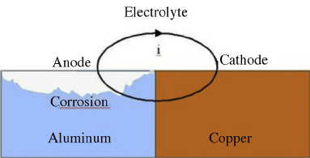

Galvanic Corrosion
Have coat where aluminum touches steel
Rivets: steel to steel
Alum to alum
Avoids erosion

Slide 18
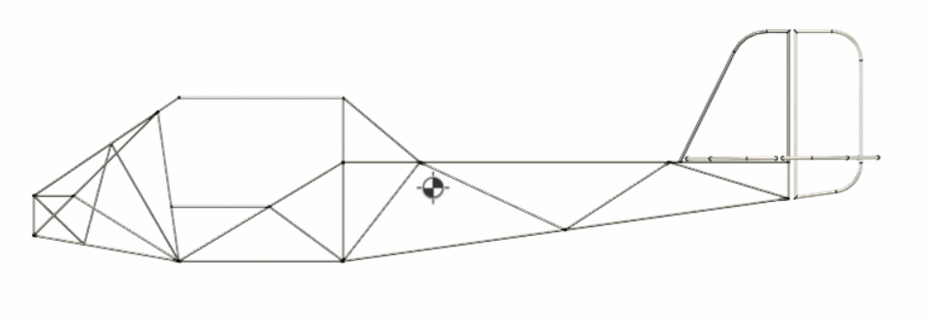
Usage on the Plane: Truss
Everything is 5/8" x 0.035” 4130 chromoly steel (for now)
Notes:
For the future
Ideas for more workshops:
Learning curves
How to attack designing things
Example leading edge,
Generally more in depth of how to design
General ideas for improvements:
Newer concepts : a work day would be helpful
More interactive in general as well

